Slide 1
Assembling and Disassembling the CPU.

Slide 2
Disassembling a PC
Requirements for Disassembling:
P.C Which is assembled
Screw driver
Cutting player
Tester

Slide 3
Procedure:
Step1: Shut down the PC if it is running
Step2: Switch of power supply and remove power cables from the power supply switch.
Step3:Remove all the cables connected to CPU i.e.,.
Power plugs which are connected to CPU and Monitor
Remove all the cables from Input/ output panel ports.
Display cable
Keyboard
Mouse
Printer and LAN
Audio ports
Serial Port

Slide 4
Step4: Remove the screws of the slides from the cabinet and then remove the slides from the Cabinet
tep5:Remove the power cables and data cables which are connected to mother board and hard disk, CD-Drive , Floppy Drive.
Step6: Remove the front panel cables from the motherboard which are power –led , key switch, hard disk ,drive led, Reset switch led, turbo switch led.
Step7: Remove the cable of Mother Board speakers.
Step8: Remove the screws of SMPS and Remove SMPS from the Cabinet.

Slide 5
Step9: Remove all expansion cables from motherboard which are LAN, MODEM, Display…
Step10: Remove the screws of Hard Disk , CD-Drive and Floppy drive and then remove Hard Disk, CD-Drive , Floppy drive from the Cabinet.
Step11: Remove the Screws of Mother Board and then remove motherboard from the cabinet.
Step12: Remove the Locks of RAM and then remove the RAM from motherboard

Slide 6
Step13:Remove the Power cable of processor Fan.
Step14: Remove the Locks of Processor fan and the Remove Fan from the Processor.
Step15: Remove the heat sinker from Processor.
Step16: Open interlocks of processor and then remove the processor from processor slots/slogs.
Step17: Remove the CMOS Battery (Locks) from the Motherboard

Slide 7
ASSEMBLING
REQUIREMENTS FOR ASSEMNLING THE P.C TOOLS:-
Screw Driver
Cutting Player
Tester
COMPONENTS FOR P.C:
Case
Mother Board (ATX & NLX)
Connectors
Power supply
Front Panel (power switch led)
Back I/O panel (serial, parallel , USB Ports
Expansion Slots
Memory module
CPU
Fans and Filters.

Slide 8
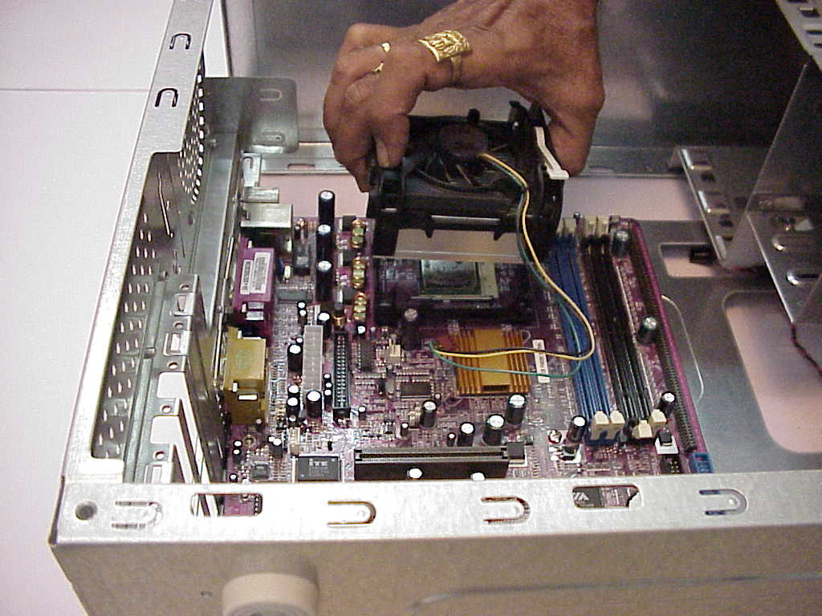
Steps Required for P.C ASSEMBLING:
Step1: Installation of CPU(Follow motherboard Manual)Install Heat sinker Fan, do CPU arrangements , CPU sockets and Slots.

Slide 9
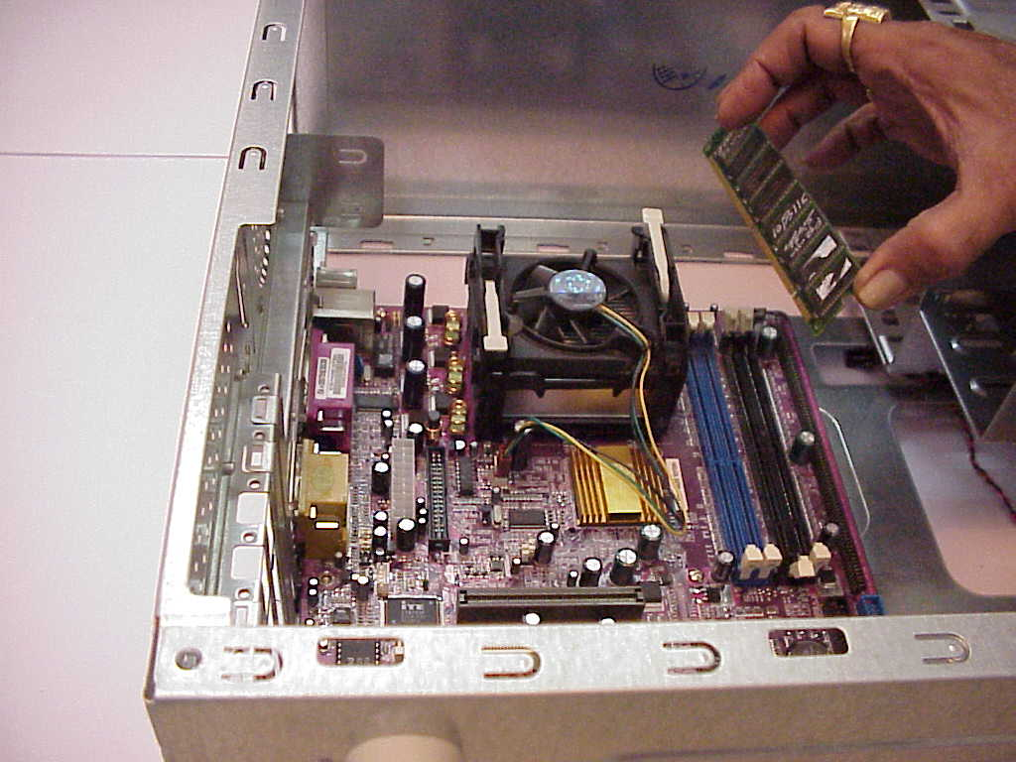
Step2: Installation of Memory , SDR and DDR Memory.

Slide 10
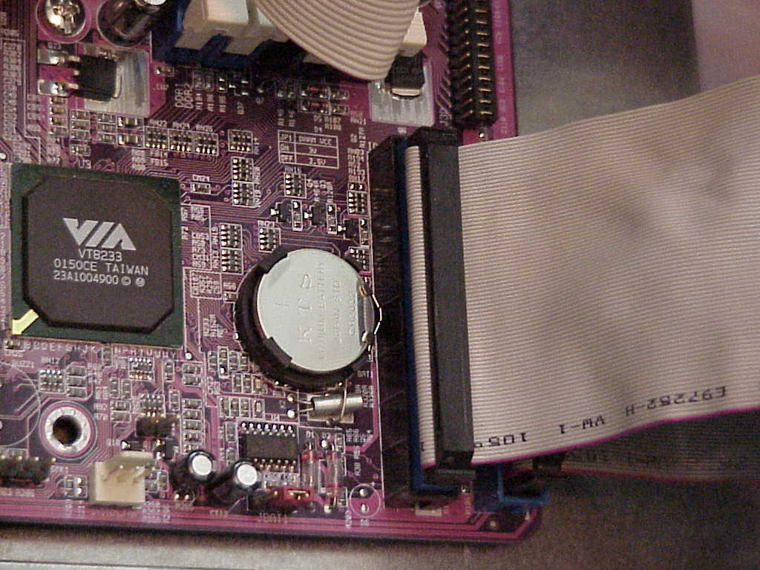
Step3: CMOS Battery installation (configure, Clock speed, Jumper and multiplier Jumper)

Slide 11
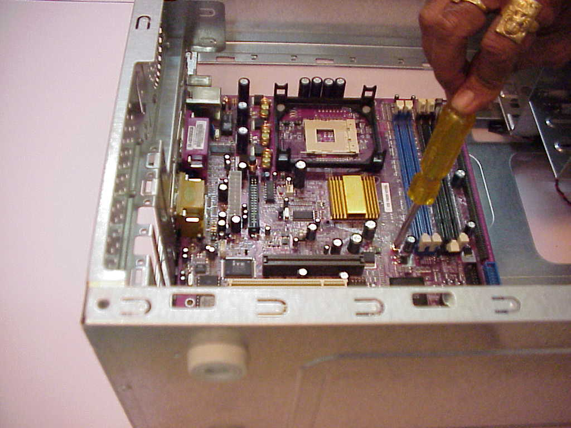
Step4: Install motherboard in case. Install wires for front panel and mother power connectors.
Take antistatic precautions property mount motherboard and screws it with screws gently, properly aligns expansion slots and ensure ports. Proper accessibility at the back.

Slide 12
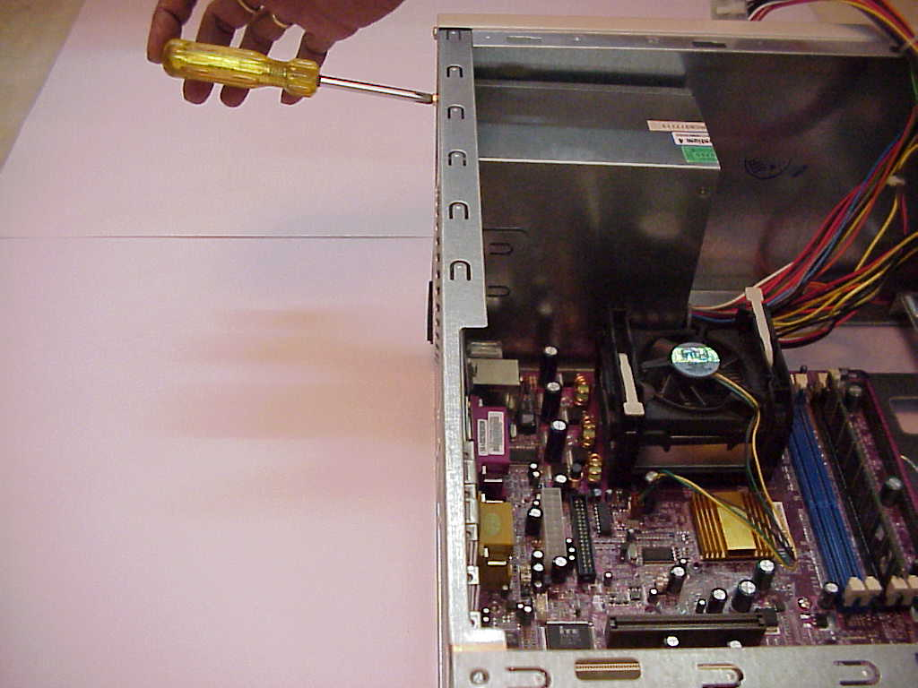
Step5: Case wiring (front panel ports) connect various wires like those power led, Keys which restart switch, HDD led, Turbo switch and etc. to corresponding motherboard positions.
Step6: Install the power supply (install SMPS)

Slide 13
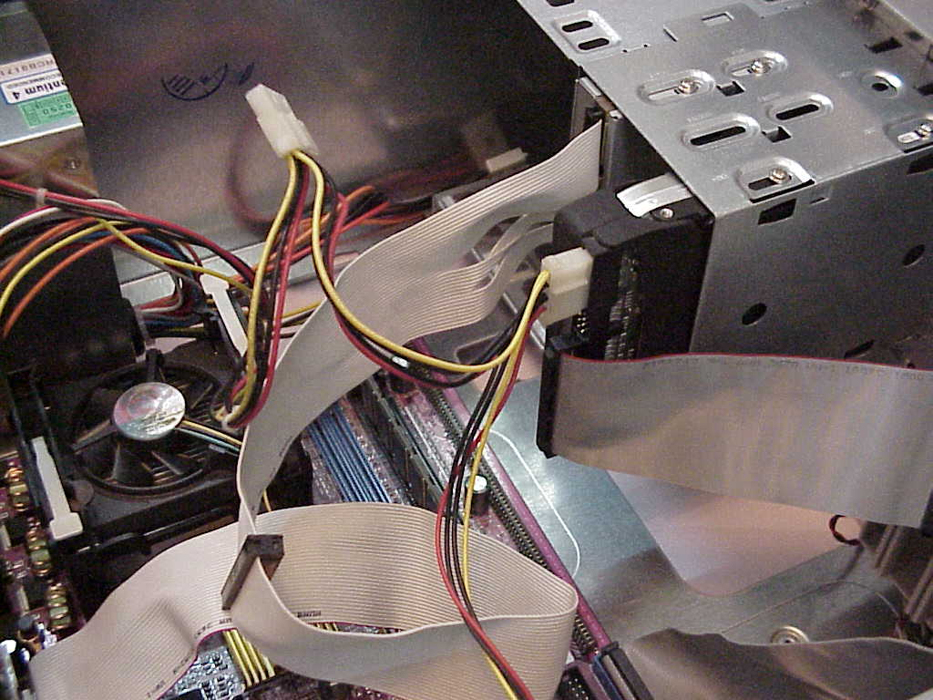
Step7: Hard disk drive system installation. As Motherboard already provides a aide HDD controller, simply connect hard disk drive to this controller, and enable controller. Take HDD cable of 40 Pins and attach correct and to the 40 pin HDD header on the Motherboard

Slide 14
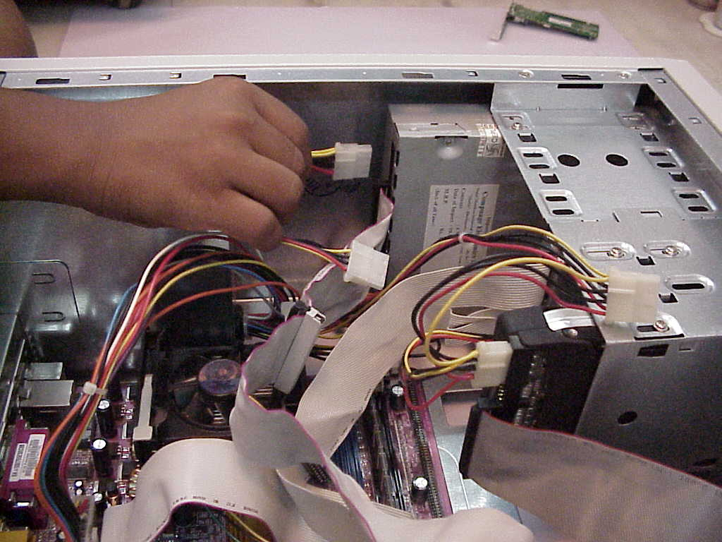
Step8: CD-ROM Drive:
Installing on IDE (Integrated Development Environments) secondary channel of the controller. Explain connections pin alignments, master slave combination.

Slide 15
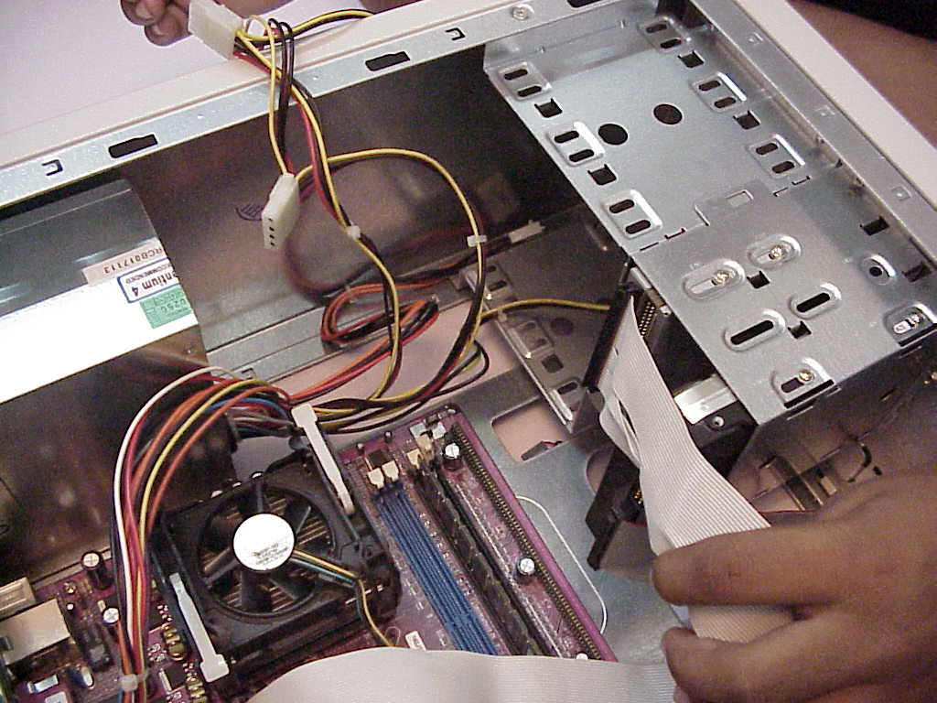
Step9:Floppy drive installation
If controller already is motherboard, don’t install a new controller, simply connect the floppy drive cable to an attach the controller. End to the 34 pin floppy drive disk (FDD) Header on the motherboard (take care of pins Alignments)

Slide 16
Step10:Sound board Installation:
Installing an audio card, which use different interrupts .IVO address and one DMA channel(Direct memory access). Beware of hard complies plug and plug type to do automatically other jumper settings like MIDI and game board setting.
Step11:System precaution:
Before closing things up, check whether all Hardware is physically, properly installed and connected before installing on hard disk, check the following
Securing of motherboard , expansion boards and etc., no louse screws.
Check proper seating of expansion cards no interference with CPU RAM Chips.
Routing properly , Ribbon cables etc.. always from heat of supply , Fans, Video ports.

Slide 17
Step12: Back up the CMOS
If motherboard has a video port already attached. Connect monitor to this port , enable video controllers, loading monitor drivers, choosing resolution.
Step13:Keyboard Installation
Attach the keyboard cable to the corresponding port in the case. This port would be connected to motherboard.
Step14:Install the Mouse
If there is a serial port to connect attach cable to proper connectors.
Explain difference with PS/2 mouse and adaptor
Explain bus mouse and how it is configured in open ISA slot.

Slide 18
Step15:Burn in Test
Check component Failures by keeping devices and PC powered on long periods after it is completely and successfully assembled.
Step16:Step Button Up
When all hardware components installed and connected, PC Powered on and everything working properly than close the outer casing and bolt it

